Slide 1
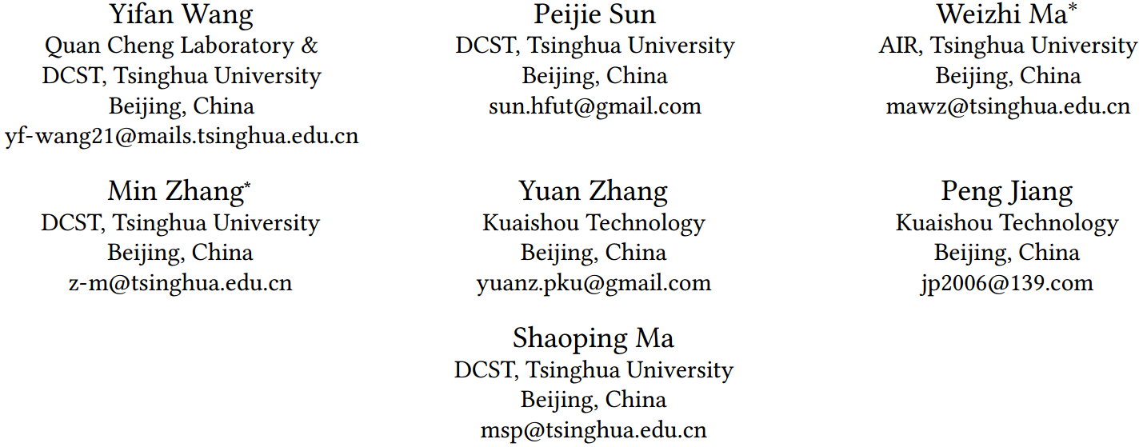
ATAI
Advanced Techniqueof Artificial Intelligence
ATAI
ChongqingUniversity _{AdvancedTechniqueof}
of Technology Artificial Intelligence
Chongqing University of
Technology
Chongqing University ^{ATAI}
_{of Technology} Advanced Techniqueof
Artificial Intelligence
Chongqing University of Technology
Chongqing University of Technology
Intersectional Two-sided Fairness in Recommendation
Code: https://github.com/yfwang2021/ITFR
2024.11.3 •ChongQing
—— WWW_2024
Reported by Shiyan Wu
1

Slide 2
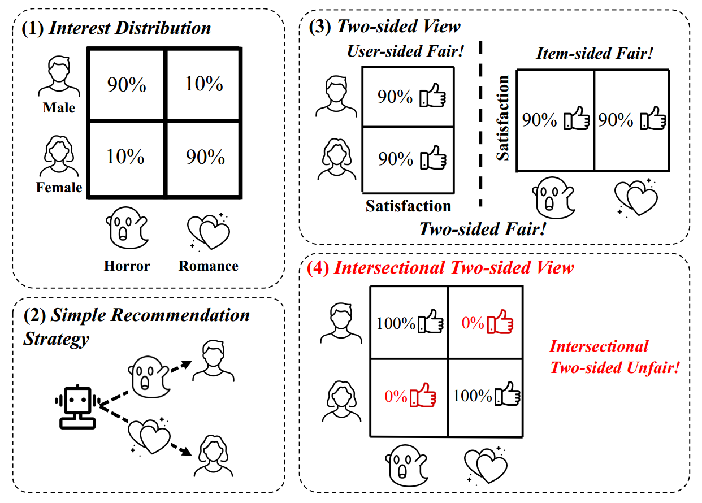
ATAI
AdvancedTechniqueof
Artificial Intelligence
ATAI
ChongqingUniversity _{AdvancedTechniqueof}
of Technology Artificial Intelligence
ChongqingUniversity of Technology
Motivation
(1) Existing research on fairness in recommender systems focuses on user and item-level fairness, failing to adequately address intersectional two-sided unfairness. Therefore, the authors propose the Intersectional Two-sided Fairness Recommendation (ITFR) method to effectively mitigate this issue and enhance fairness for different intersectional groups.

Slide 3
ChongqingUniversity of Technology
ATAI
AdvancedTechniqueof
Artificial Intelligence
ATAI
ChongqingUniversity _{AdvancedTechniqueof}
of Technology Artificial Intelligence
Overview

Slide 4
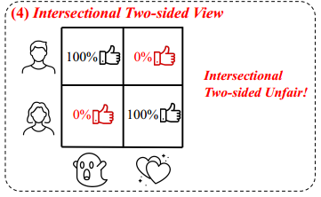
ChongqingUniversity of Technology
ATAI
AdvancedTechniqueof
Artificial Intelligence
ATAI
ChongqingUniversity _{AdvancedTechniqueof}
of Technology Artificial Intelligence
Method
(1)
(2)
(3)

Slide 5
ChongqingUniversity of Technology
ATAI
AdvancedTechniqueof
Artificial Intelligence
ATAI
ChongqingUniversity _{AdvancedTechniqueof}
of Technology Artificial Intelligence
Method
(4)
(5)
(6)
(7)

Slide 6
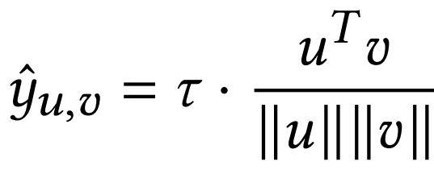
ChongqingUniversity of Technology
ATAI
AdvancedTechniqueof
Artificial Intelligence
ATAI
ChongqingUniversity _{AdvancedTechniqueof}
of Technology Artificial Intelligence
Method
(8)

Slide 7
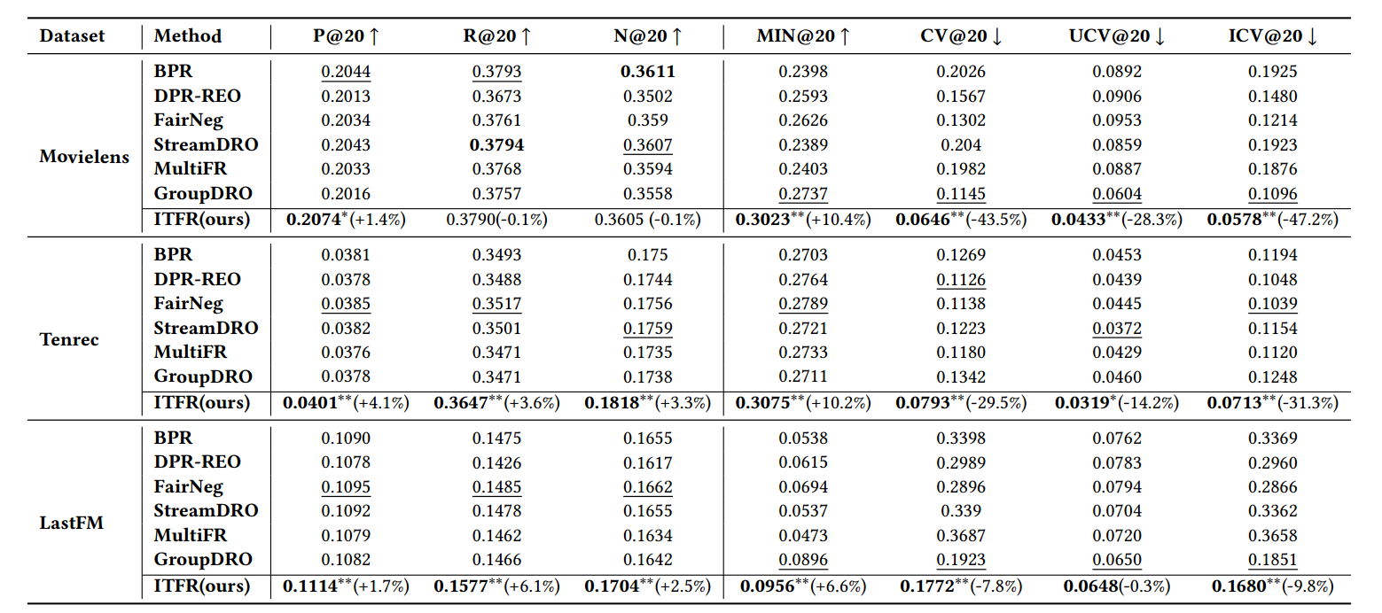
ATAI
AdvancedTechniqueof
Artificial Intelligence
ATAI
ChongqingUniversity _{AdvancedTechniqueof}
of Technology Artificial Intelligence
ChongqingUniversity of Technology
Experiments

Slide 8
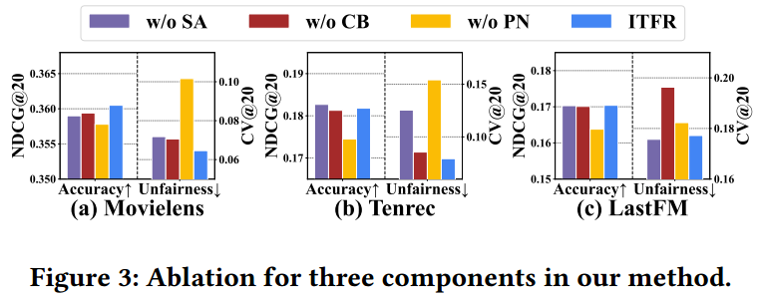
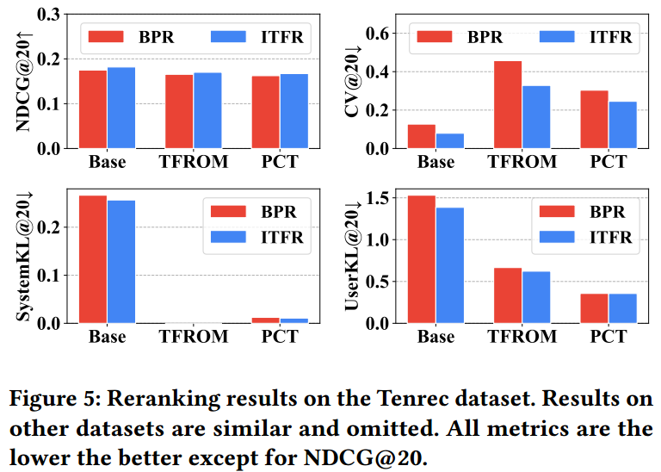
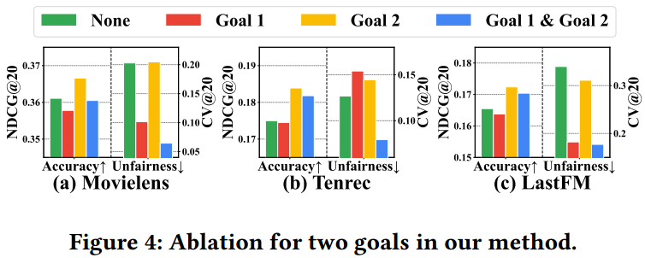
ATAI
AdvancedTechniqueof
Artificial Intelligence
ATAI
ChongqingUniversity _{AdvancedTechniqueof}
of Technology Artificial Intelligence
ChongqingUniversity of Technology
Experiments

Slide 9
ChongqingUniversity of Technology
ATAI
AdvancedTechniqueof
Artificial Intelligence
ATAI
ChongqingUniversity _{AdvancedTechniqueof}
of Technology Artificial Intelligence
Thanks!

